Slide 1
Employee salary prediction
By linear regression algorithm

Slide 2
objective
We have to predict the salary of an employee given how many years of experience they have.

Slide 3
Abstract:
Machine learning is a technology which allows a software program to became more accurate at pretending more accurate results without being explicitly programmed and also ML algorithms uses historic data to predicts the new outputs. Because of this ML gets a distinguish attention. Now a day’s prediction engine has become so popular that they are generating accurate and affordable predictions just like a human, and being using industry to solve many of the problems. Predicting justified salary for employee is always being a challenging job for an employer. In this paper and proposing a salary prediction model with suitable algorithm using key features required to predict the salary of employee.

Slide 4
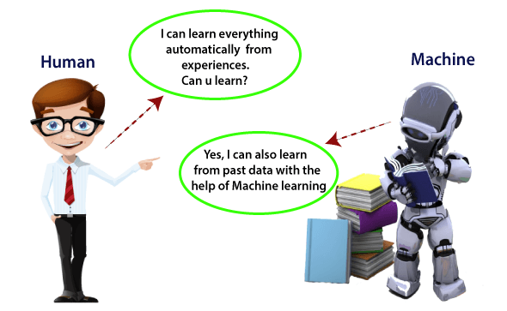
Machine learning

Slide 5
Action:
Data collection
Preprocessing
Feature extraction
Model creation
Model training
Prediction
evaluation

Slide 6
algorithms
Linear regression is one of the easiest and most popular Machine Learning algorithms.
It is a statistical method that is used for predictive analysis.
Linear regression makes predictions for continuous/real or numeric variables such as sales, salary, age, product price, etc.

Slide 7
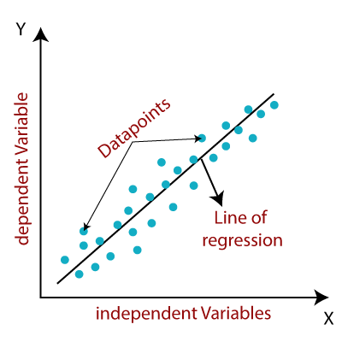
Linear regression algorithm shows a linear relationship between a dependent (y) and one or more independent (X) variables,

Slide 8
Solving problems with Data science
Possible Questions
Desired algorithms
How much or How many ?
Regression
Is it A or B?
Classification
How is this organized ?
Clustering
How different is this ?
Anamoly Dectection
What to do next ?
Reinforcement learning

Slide 9


Model Planning – Use case
Train data vs Test data
Train data is used to develop model
Test data is used to validate model
Train Data
(80%)
Model is created
Test data
(20%)
Feedback
Improvement

Slide 10


Slide 11


